Slide 1
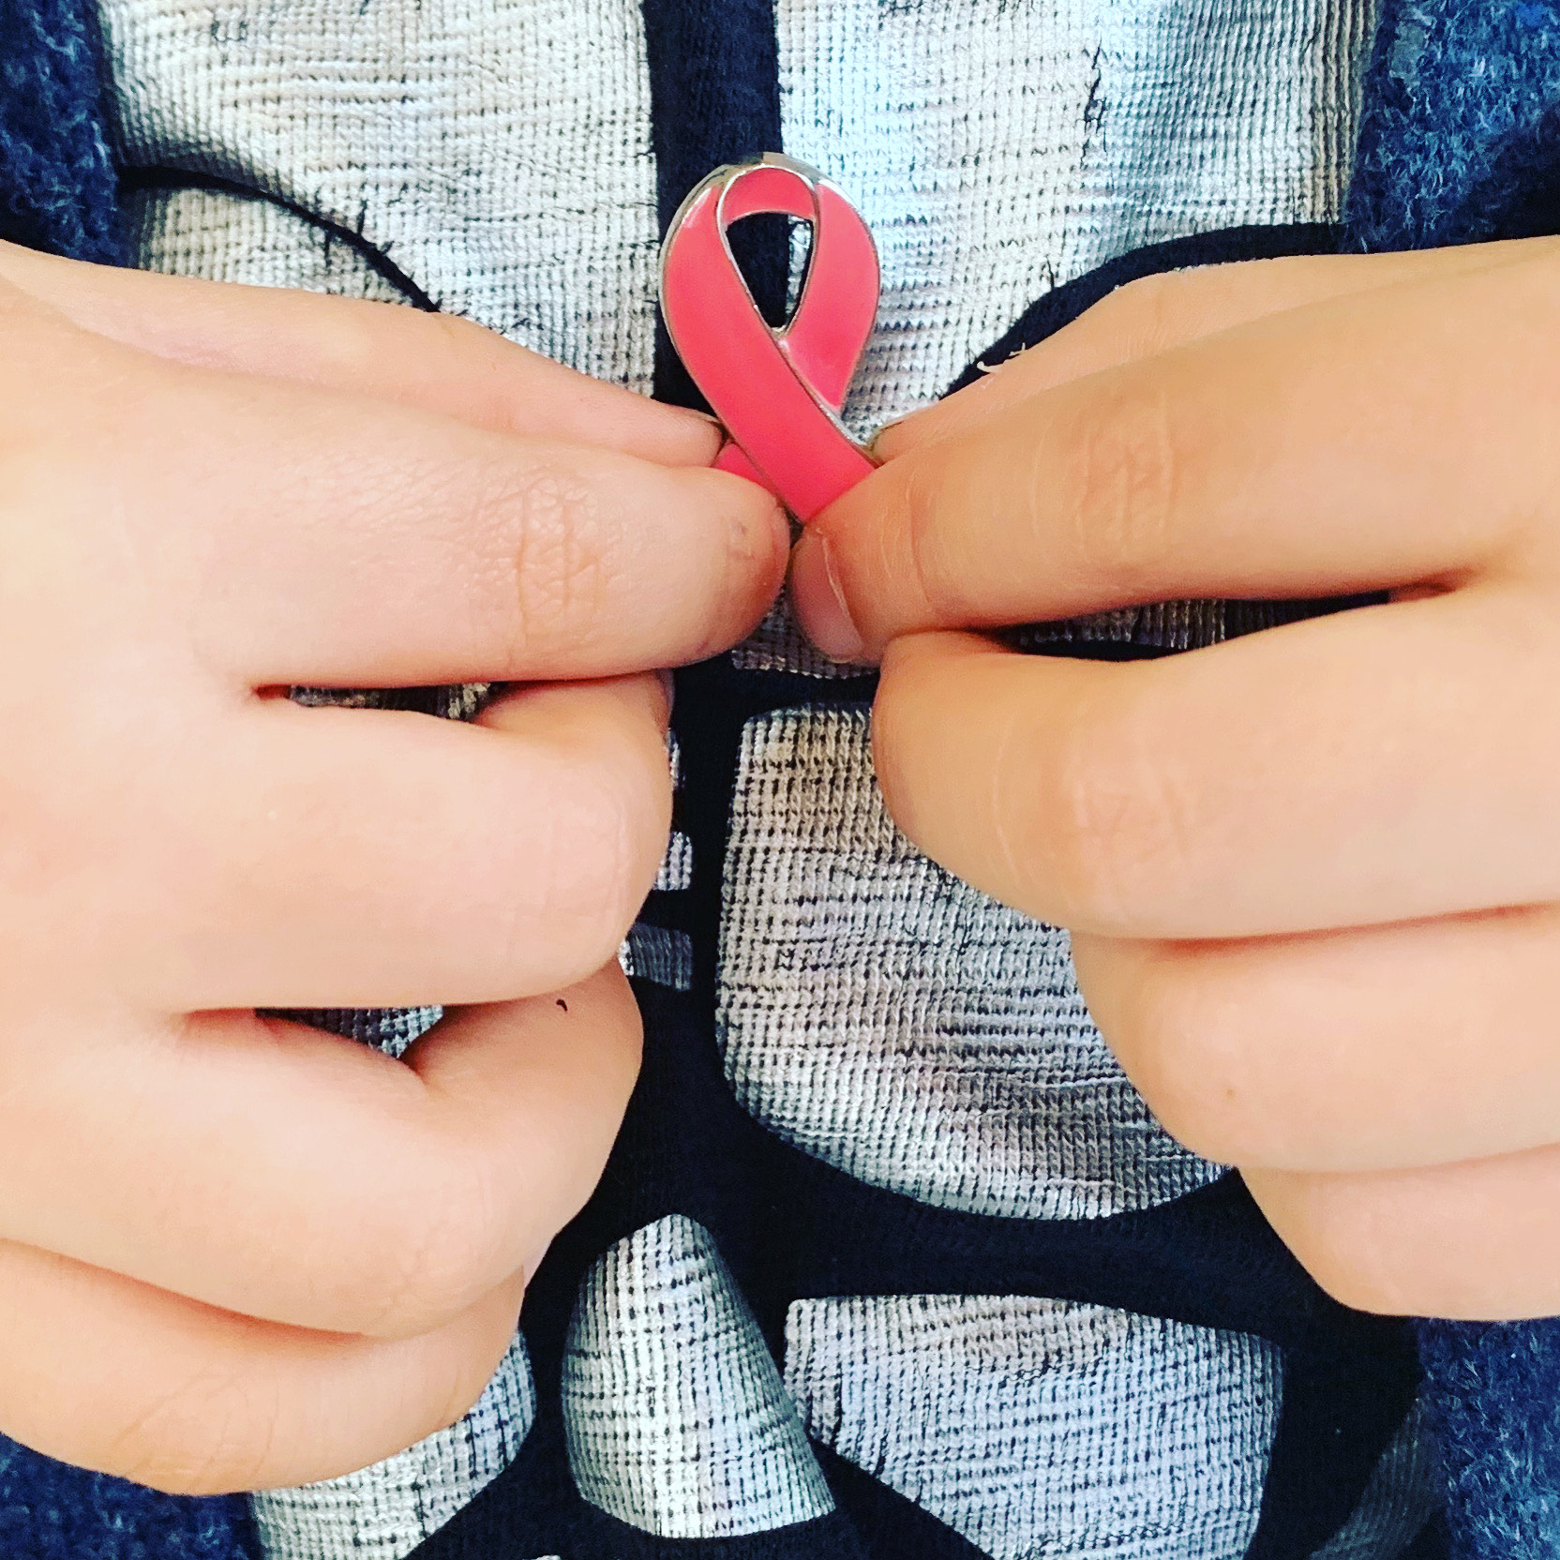
Raising Breast Cancer Awareness
Aika Matsunoki Akavia M.D., Ph.D

Slide 2
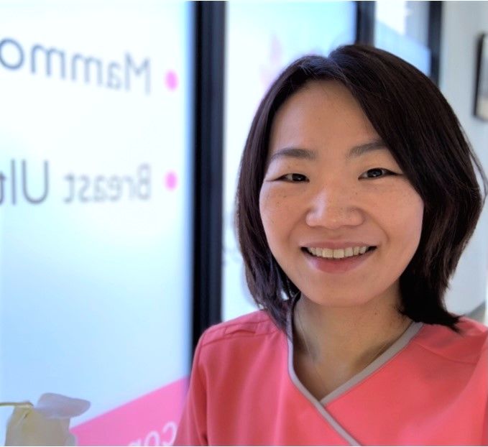
About myself
Director of Aika Breast Clinic
My specialty
Breast cancer screening, diagnosis and treatment.
Certification
Board Certified Breast Specialist, Japanese Breast Cancer Society
Board Certified General Clinical Oncologist, Japanese Board of Cancer Therapy
Board Certified Surgeon, Japan Surgical Society

Slide 3
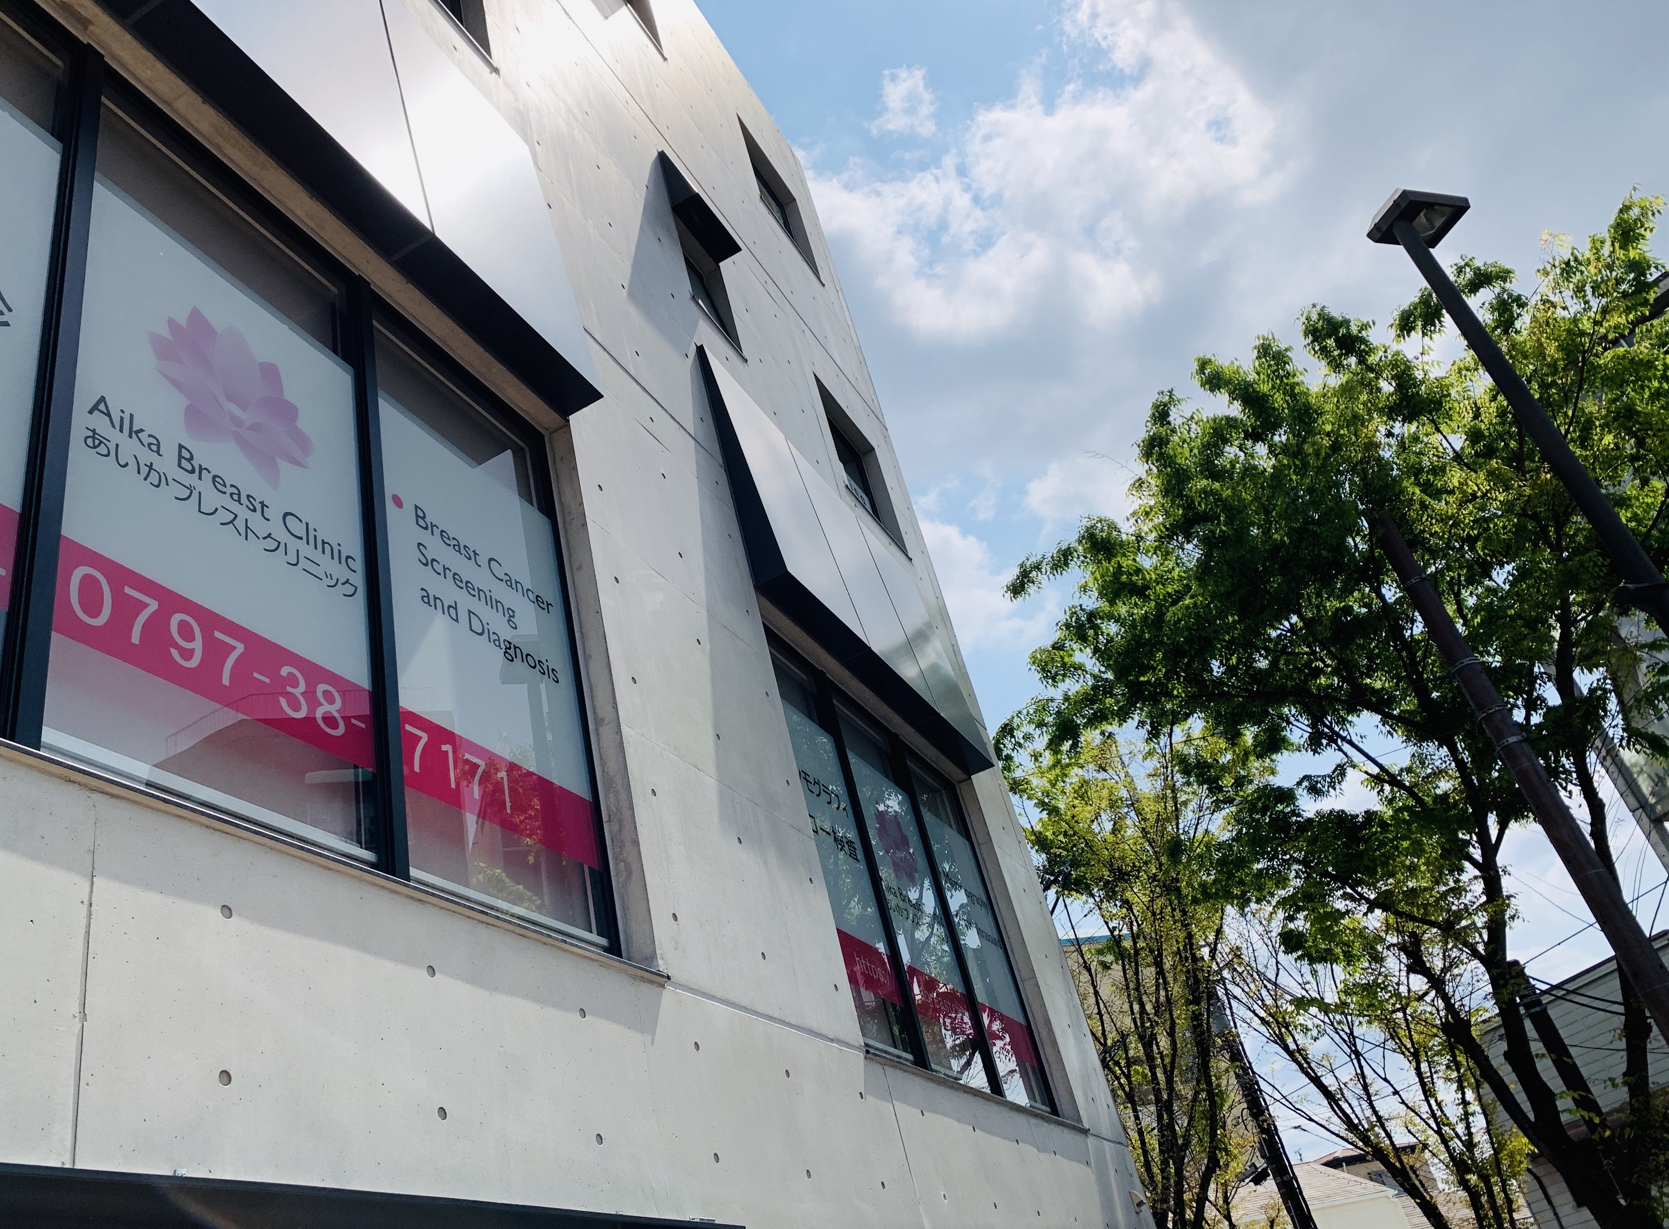
Aika Breast Clinic is your next-door clinic for all breast issues in Ashiya, Japan.
Tokyo
Kobe
Osaka

Slide 4
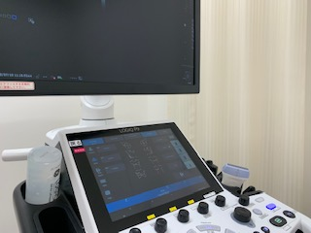
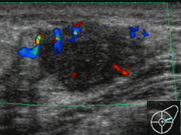
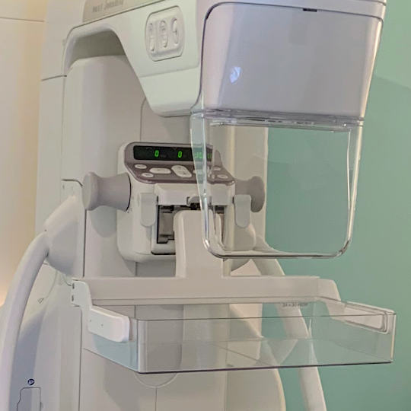
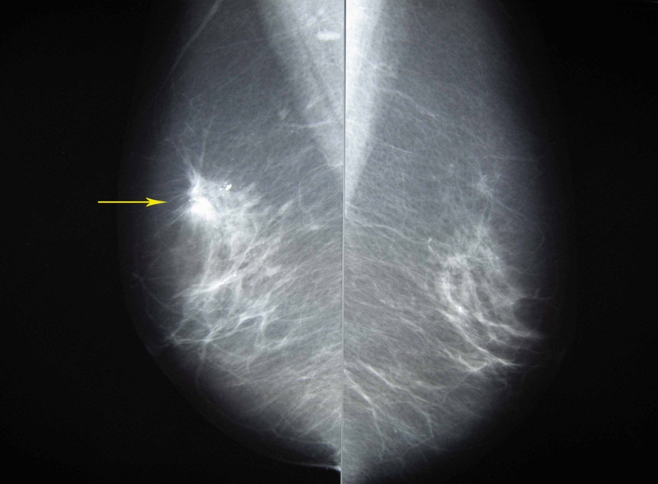
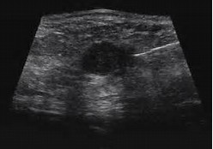
What we do?
Breast ultrasound
Breast cancer
screening and diagnosis
One stop-service
Female breast cancer specialist and team
Mammogram
Breast biopsy
X-ray of the breast

Slide 5
What we do?
Breast Cancer treatment in the partner with
cancer center, local hospitals and university hospitals in Kansai area.
Kobe
Osaka

Slide 6
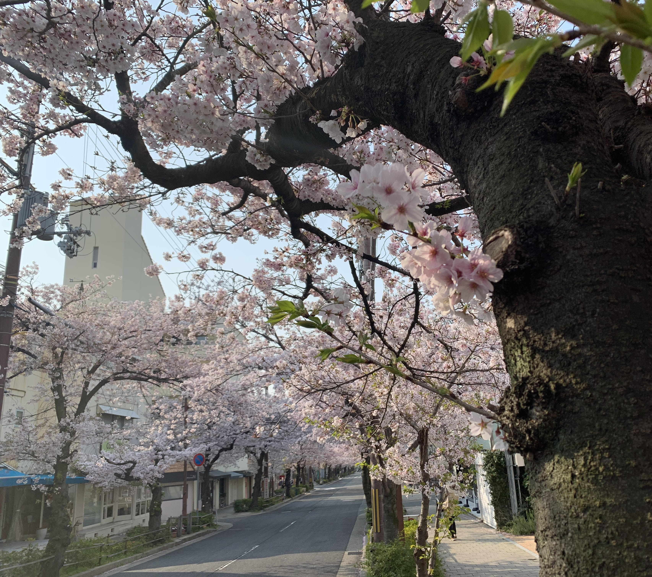
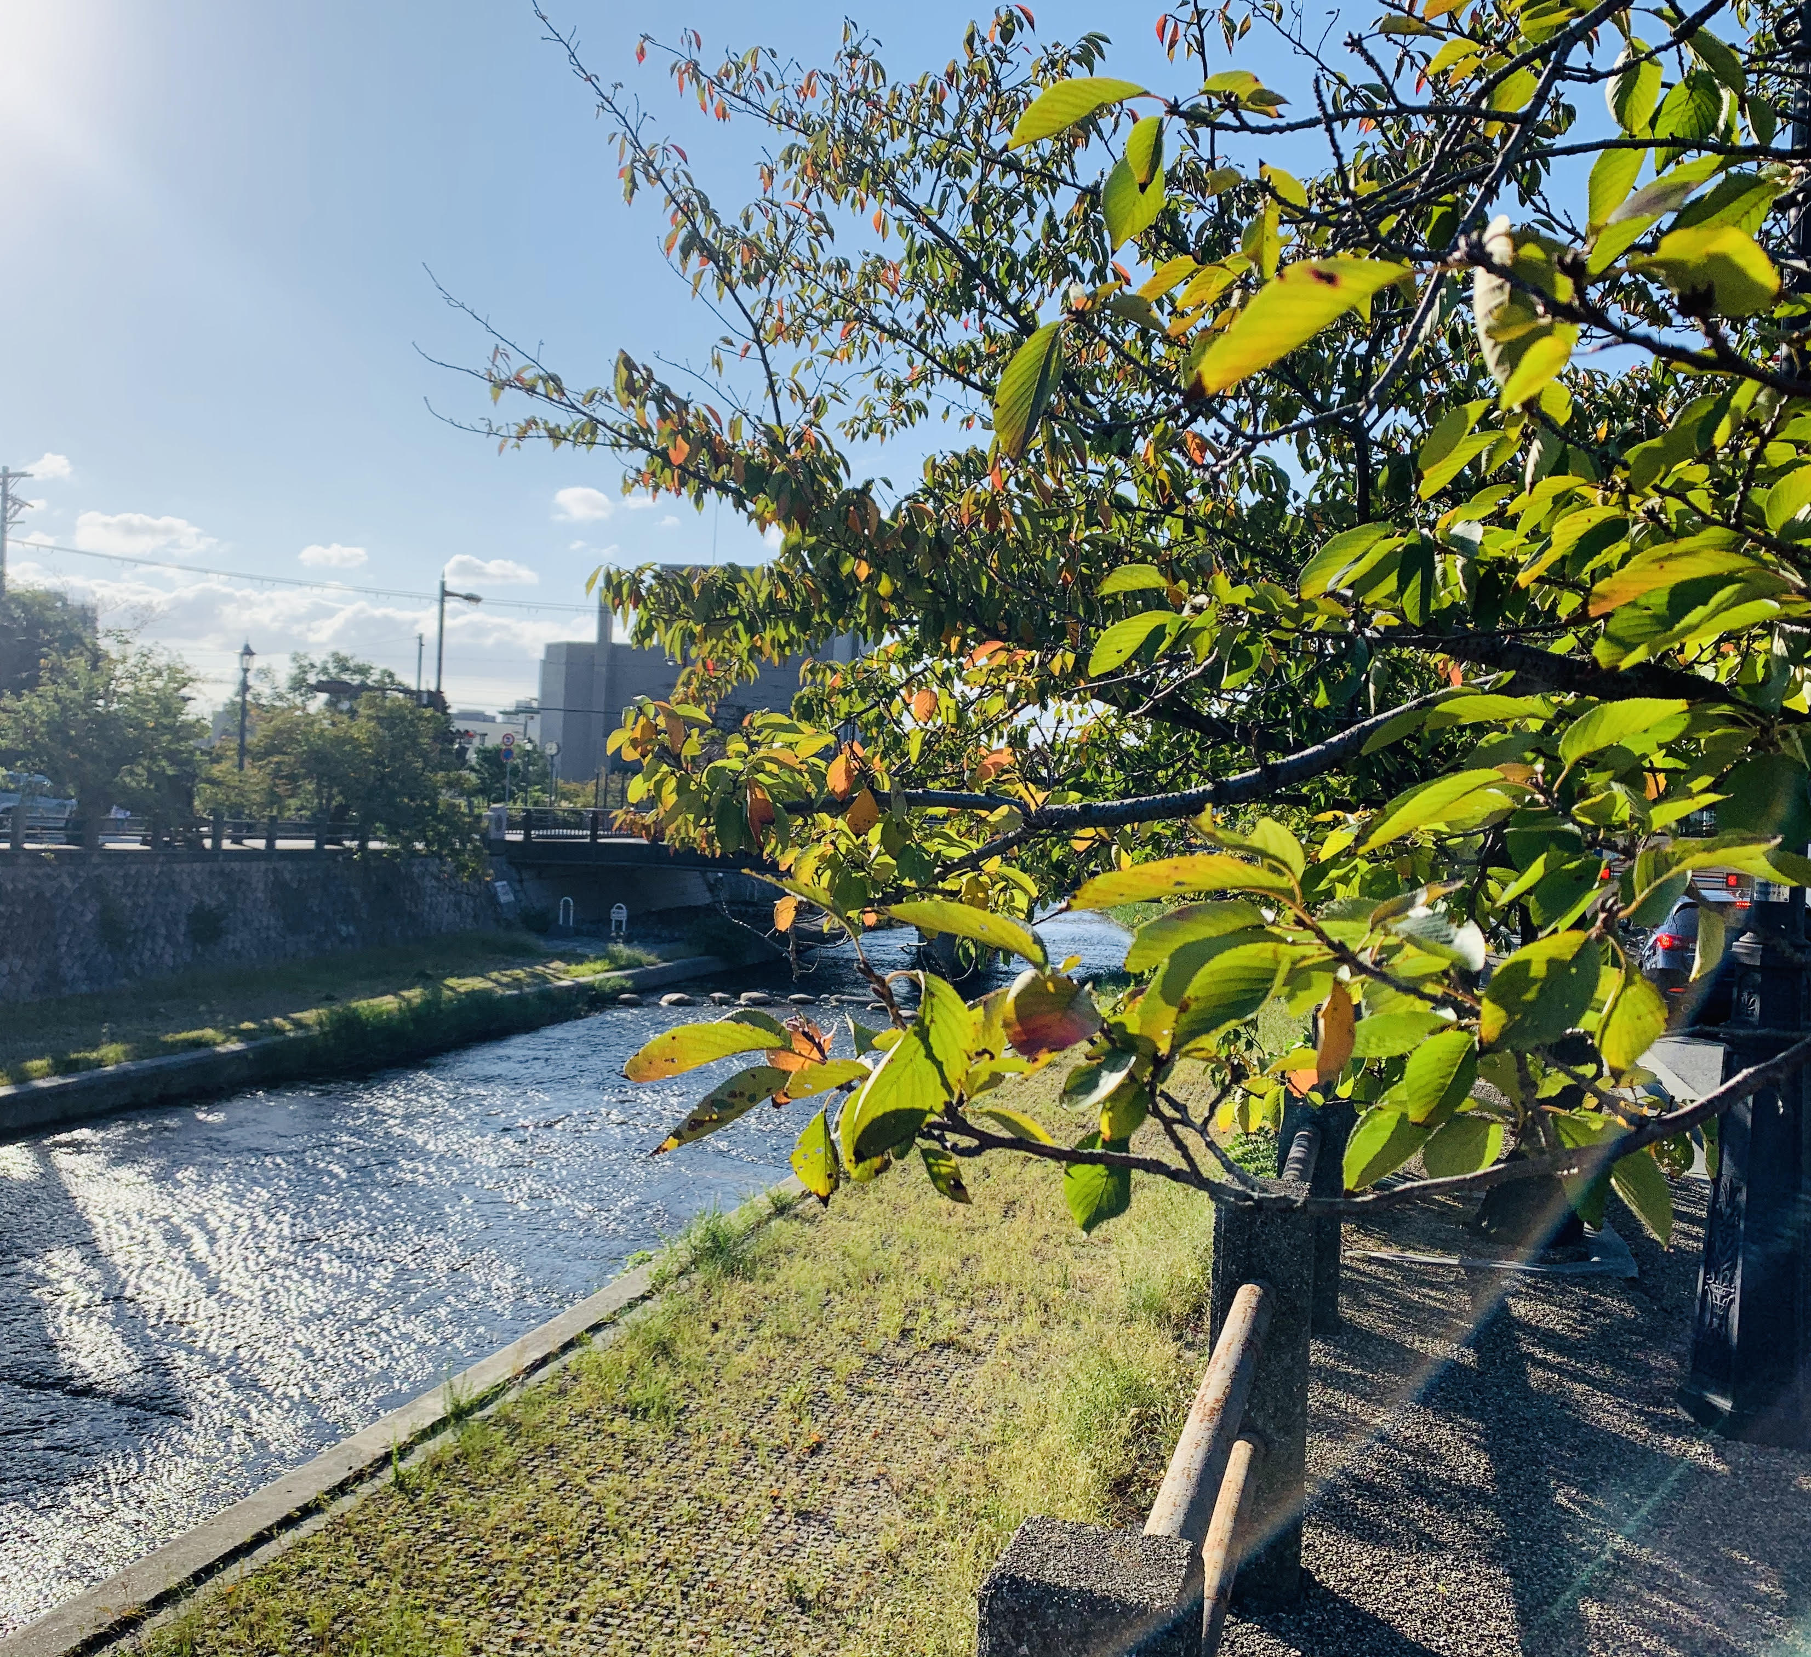
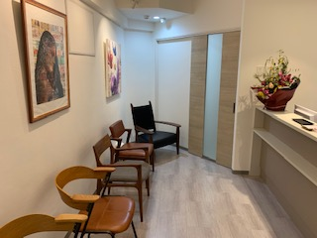
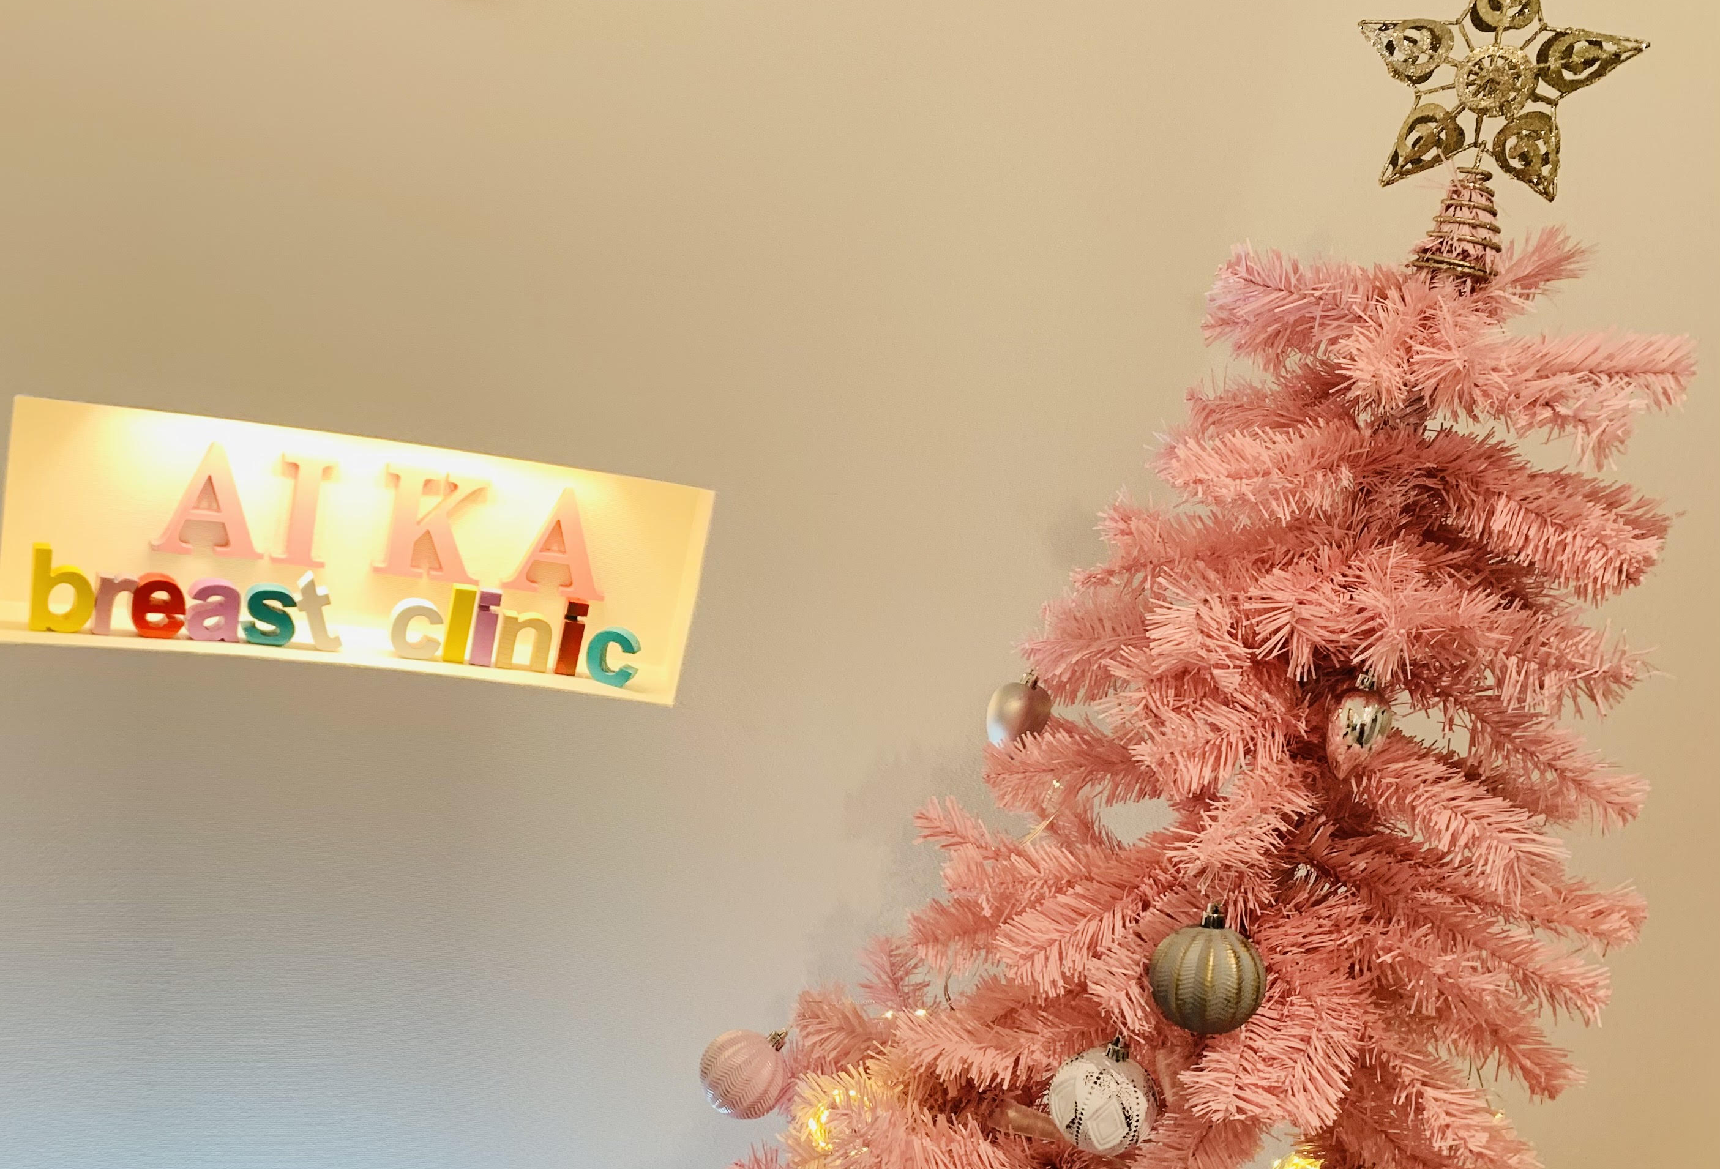
Relaxing environment
Located in Ashiya city
Charming and cozy neighborhood
Easy access to Osaka, Kobe and Kyoto
Art & music
Modern interior design
Female medical staff

Slide 7
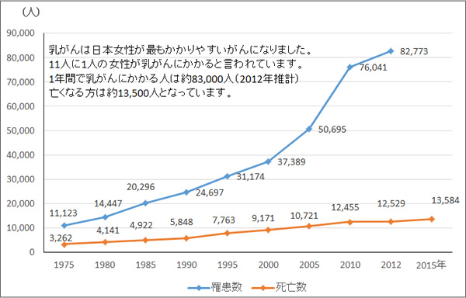
Breast cancer in Japan
In 2017
92,253
Most common type of cancer
-1 in 9 women -
Leading cause of cancer-related death
in women 20’s-60’s
incidence
In 2019
14,935
mortality
Notes:
More than 90,000 women were diagnosed with breast cancer
The incidence has been increasing since the mid-1990s
Now is the most common type of cancer affecting Japanese women.

Slide 8
Breast Cancer Incidence by Age
USA
Japanese women
more likely to have
breast cancer
in their 40’s and 60’s
younger
in the US and Europe
Japan
Notes:
Japanese women are more likely to have breast cancer in their 40’s and 60’s which is much younger than patients in the US or Europe.

Slide 9
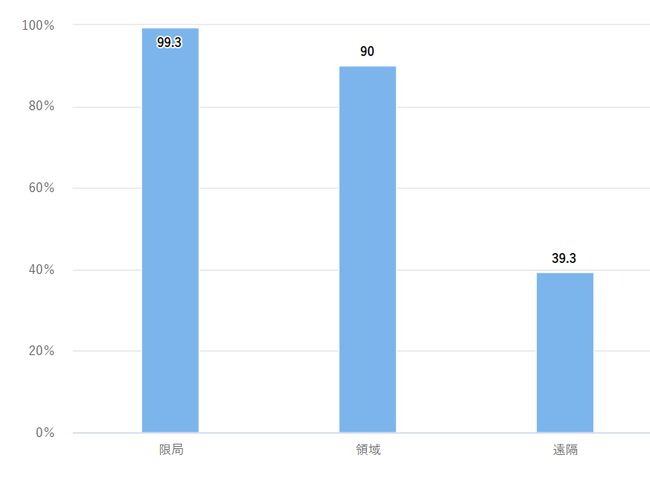
5-year survival rates for breast cancer
Earlier is easier to treat.
More treatment options!
Early
Advanced
Localized
Regional
Distant
乳房：[国立がん研究センター がん統計] (ganjoho.jp)
Notes:
The survival rate for women diagnosed with breast cancer is now around 90 percent or higher when it is detected in the early stages. Localized: There is no sign that the cancer has spread outside of the breast.
Regional: The cancer has spread outside the breast to nearby structures or lymph nodes.
Distant: The cancer has spread to distant parts of the body such as the lungs, liver or bones.

Slide 10
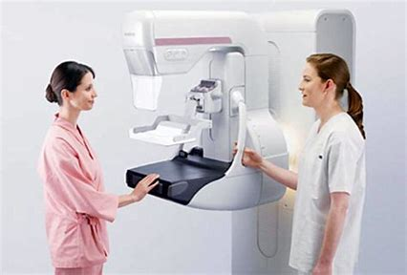
To overcome breast cancer
Better Medicine
Supportive Care for Patients in community
Cancer Prevention
Awareness, Cancer Education
Healthy habit and life style to reduce cancer risks
Breast Cancer Screening

Slide 11
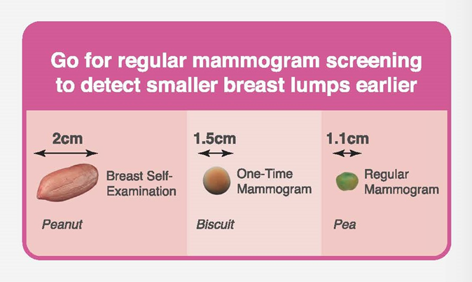
Get screened! Early detection saves lives
Mammogram can detect tiny abnormalities even before they can be felt.
Screening program can reduce breast cancer mortality by around 20%.
Additional US besides MMG may have benefit for Japanese women in 40’s.
https://www.singaporecancersociety.org.sg/about/about-scs/careers/45-get-screened.html

Slide 12
Breast cancer mortality
USA and Europe⇓
Due to better screening and advances in treatment,
breast cancer mortality rates have been declining in the US and Europe.
…Not in Japan
UK
France
Italy
US
Japan ↑
JAPAN

Slide 13
Breast Cancer screening rates
Only 41% of Japanese women screened
OECD iLibrary | Screening, survival and mortality for breast cancer (oecd-ilibrary.org)
Notes:
the screening rate in Japan is only 41 percent
日本の検診受診率は、国際的に低い値となっています。アメリカと比べると約40ポイントも下回っています。医療費の高いアメリカでは、雇用主提供医療保険や公的医療保険の多くでカバーできる予防医療（検診など）をかかりつけ医が勧めており、その結果、高い受診率を保っているものと考えられます。二番目に受診率の高いイギリスでは、国策として組織型検診が実施されています。検診の対象がきちんと明確化され、個人が特定化された名簿に基づいて受診勧奨を行う体制が整っているため、高い受診率を維持できています。

Slide 14
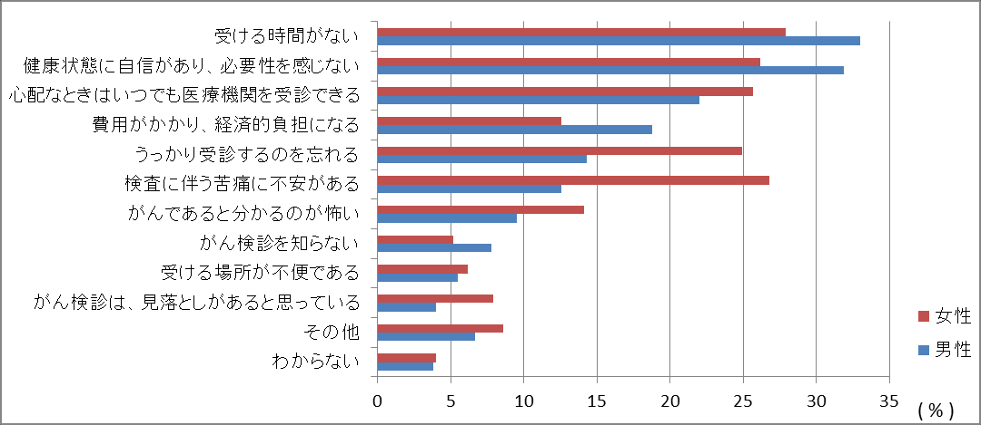
Why Japanese women don’t get screened?
Anxiety and fear
Lack of knowledge
Just forgot!
Etc.
Convenient and comfortable environment for women
Help women to access screening
Remind them to check their breasts!
Reduce social or economic barriers
Notes:
では、どういった理由で検診を受けないのでしょうか。内閣府が実施しているがん対策に関する世論調査で、以下のような理由が抽出されました。
がん検診についてその重要性や正しい知識が定着していない
不安を取り除くためのサポート
経済的負担」を上げている人も多くみられました。市町村のがん検診は安価で受診することが出来る
Time – busy with work, taking care of kids and family
Fear - what if I have cancer?
Money – It costs a lot
Biased -I don’t get cancer.
Pain – I heard mammogram is painful
Misunderstanding – I will see a doctor when I have problems

Slide 15
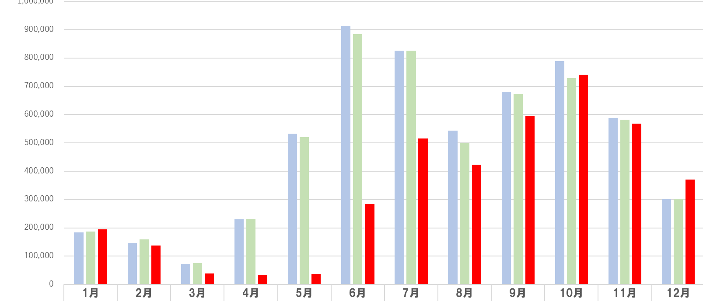
COVID-19’s impact on All Cancer Screening Rates in Japan
2020
2019
2018
Declaration of a state of emergency
stay-at-home
School closed
2020年の受診者30％減、約2100のがん未発見の可能性 日本対がん協会32支部調査 | 日本対がん協会 (jcancer.jp)
Notes:
people have been likely to avoid screening due to COVID concerns?

Slide 16
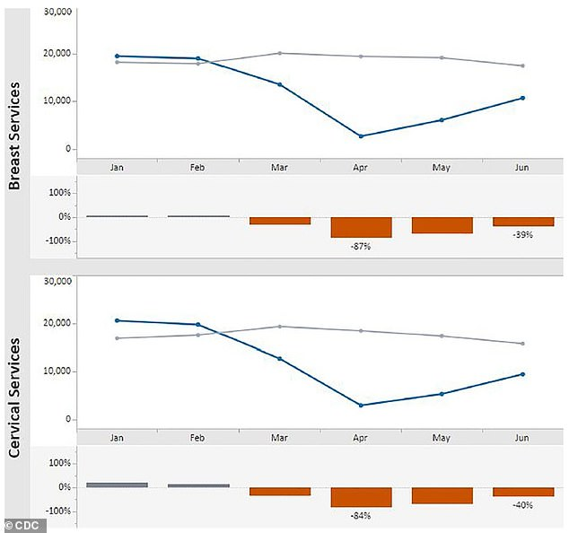
Sharp decline in cancer screenings for women during COVID-19 pandemic in the U.S.
During April 2020 compared to the previous five years…
Breast cancer screenings -87 %
Cervical cancer screenings -84 %
delayed cancer diagnosis?
Centers for Disease Control and Prevention (CDC)'s Early Detection Program
Wednesday, June 30, 2021

Slide 17
Women need to catch up on their regular screenings!
Cancer doesn’t stop in a pandemic.
When cancer is found earlier, it is easier to treat because there are more options available.
Encourage women to get screened
Don’t lose your loved one because of breast cancer
Remind your mother, sisters, friends…Don’t delay

Slide 18
Breast Cancer is Preventable
Know Risk factors:
Age
Family history of breast cancer, genetic predisposition
Reproductive factors, oestrogen replacement therapy
Lifestyles
Obesity, physical inactivity, diet and alcohol consumption.
Get screened before you have symptoms
Breast awareness

Slide 19
What is breast awareness?
Breast awareness is to get to know your body so that you know what is normal for you
Be breast aware
no matter how old you are.
Male also can get breast cancer.
Get an annual breast exam
At least over 40 years old, earlier if your relatives got breast cancer.
See your doctor if you notice any unusual changes

Slide 20
Breast cancer support group in English
Preparing a new breast cancer support network to overcome language and cultural barriers for foreigners in Japan
Online meeting – in July 2021
Looking for breast cancer survivors who are interested in our new network.
GET SCREENED
NOW!
Website: https://aikabreastclinic.com/
Email: info@aikabreastclinic.com

